Slide 1

DOCKER CONTAINER
TECHNOLOGY
PRESENT BY: LY SEANGHOUCH
REFERENCE: SIMPLI LEARN
Link video reference

Slide 2
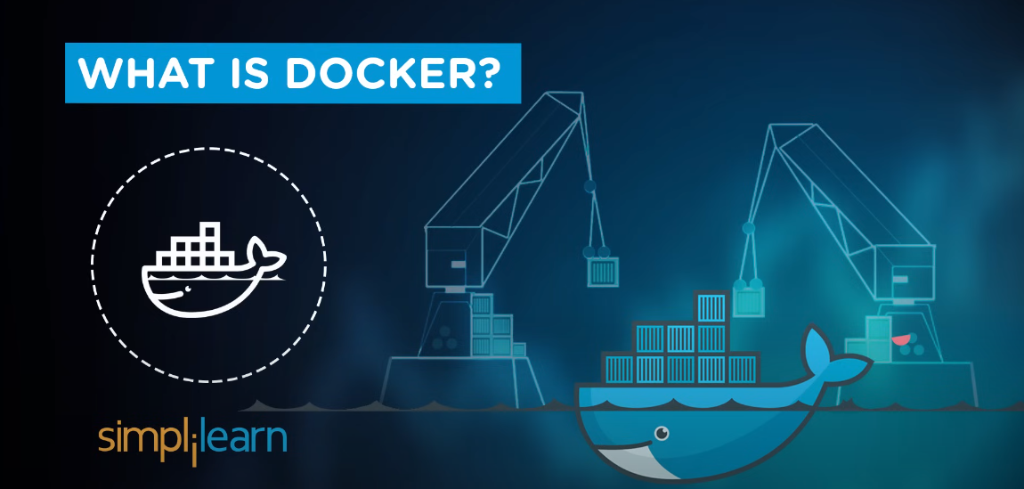

Slide 3
Docker
Docker is an open platform for developing, shipping, and running applications.
Docker allows you to separate your applications from your infrastructure so you can deliver software quickly. With Docker, you can manage your infrastructure in the same ways you manage your applications.
By taking advantage of Docker’s methodologies for shipping, testing, and deploying code quickly, you can significantly reduce the delay between writing code and running it in production.

Slide 4
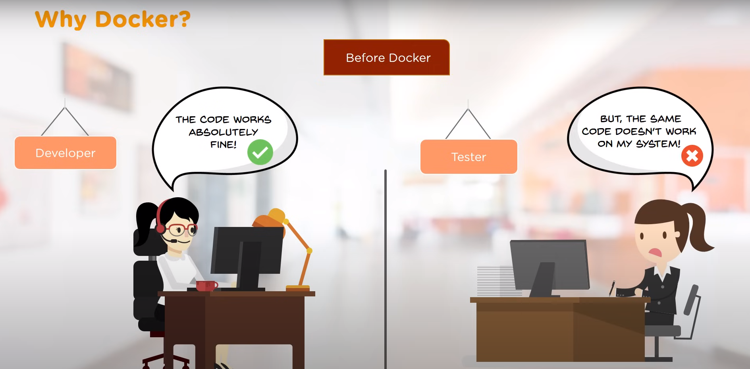

Slide 5
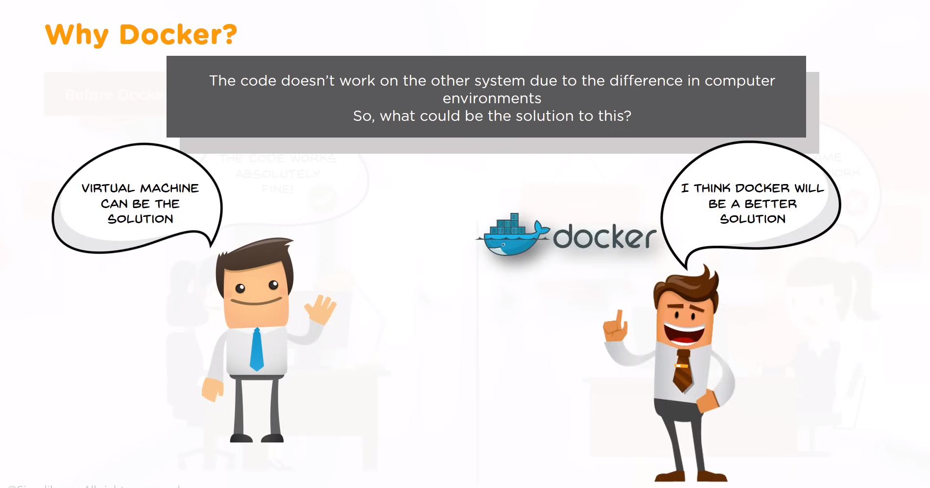

Slide 6
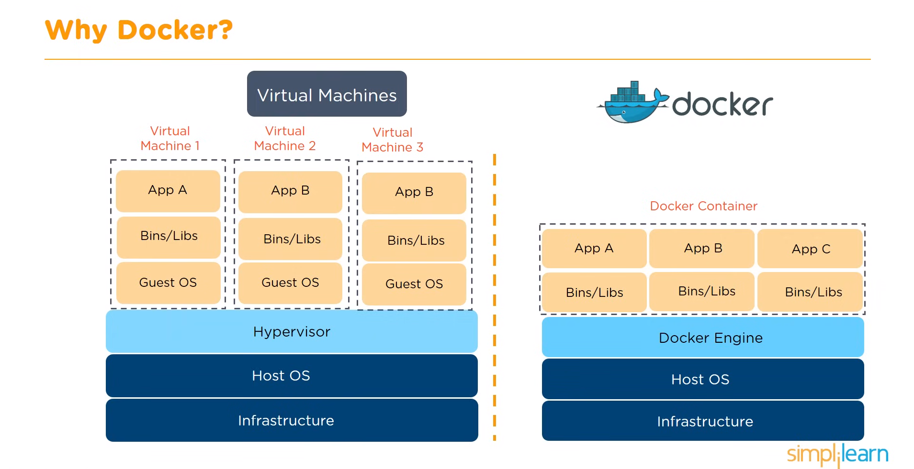

Slide 7
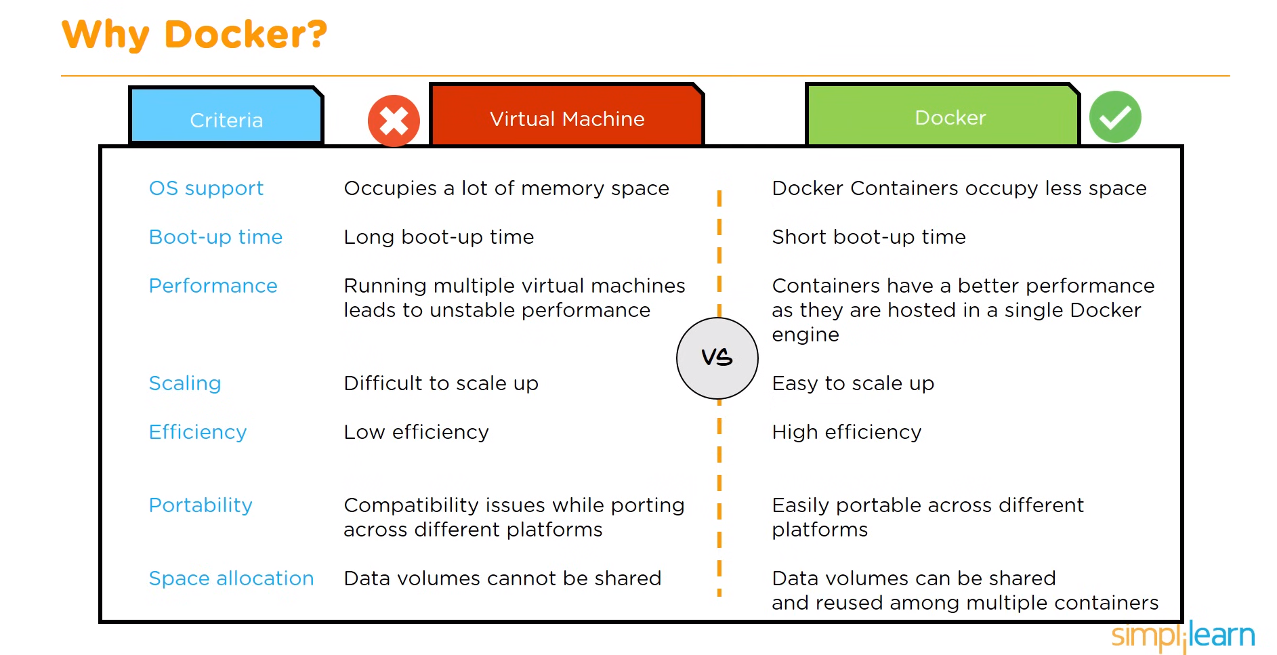

Slide 8
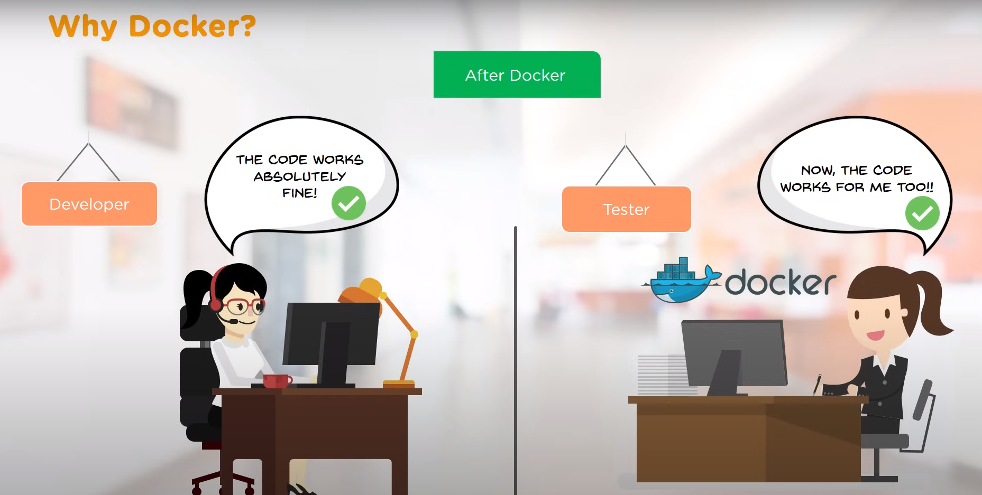

Slide 9

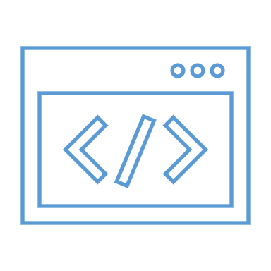
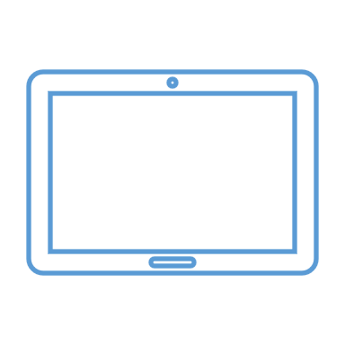
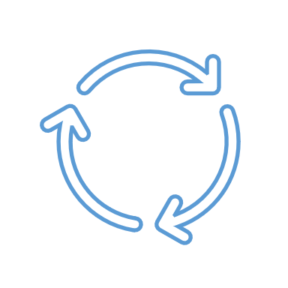
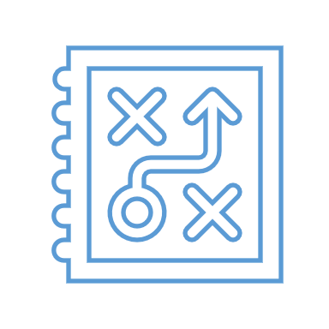
System flow
Web
API
Tablet
Third Party
Check Last update
Different last update
Database
Script
API
Web
BC
Something changed
Database

Slide 10
Reporting flow
Outlet
Outlet
API
API
New Reporting
DCenter
Company
Reporting
Outlet
Migration
Outlet
Daily Transactions
API

Slide 11
Reporting flow
Excel/CSV
UI
Schedule
Manual
SQL SERVER
Script
API
Eco Reporting
Import
Logic
Iqueryable

Slide 12
Reporting flow
Logic
URL
Odata 4.0
Angular
API
Eco Reporting
Iqueryable

Slide 13
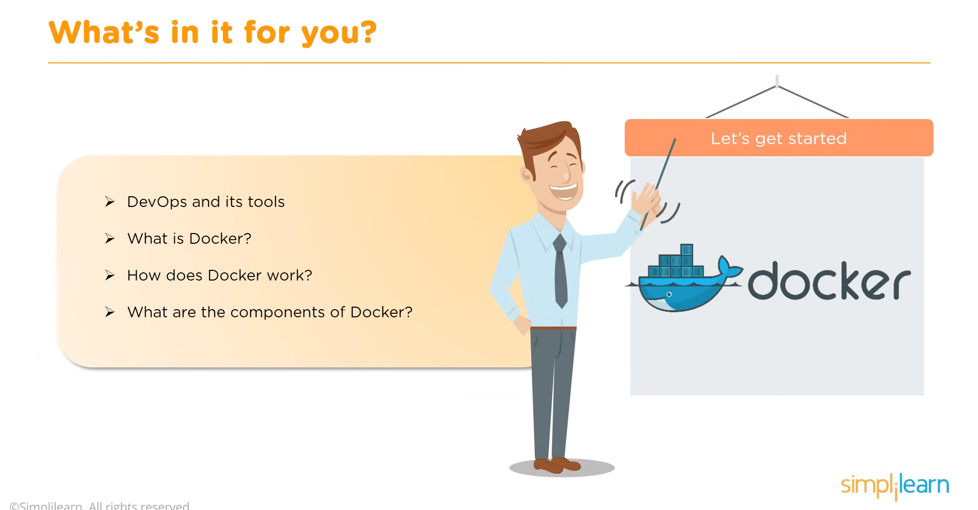

Slide 14
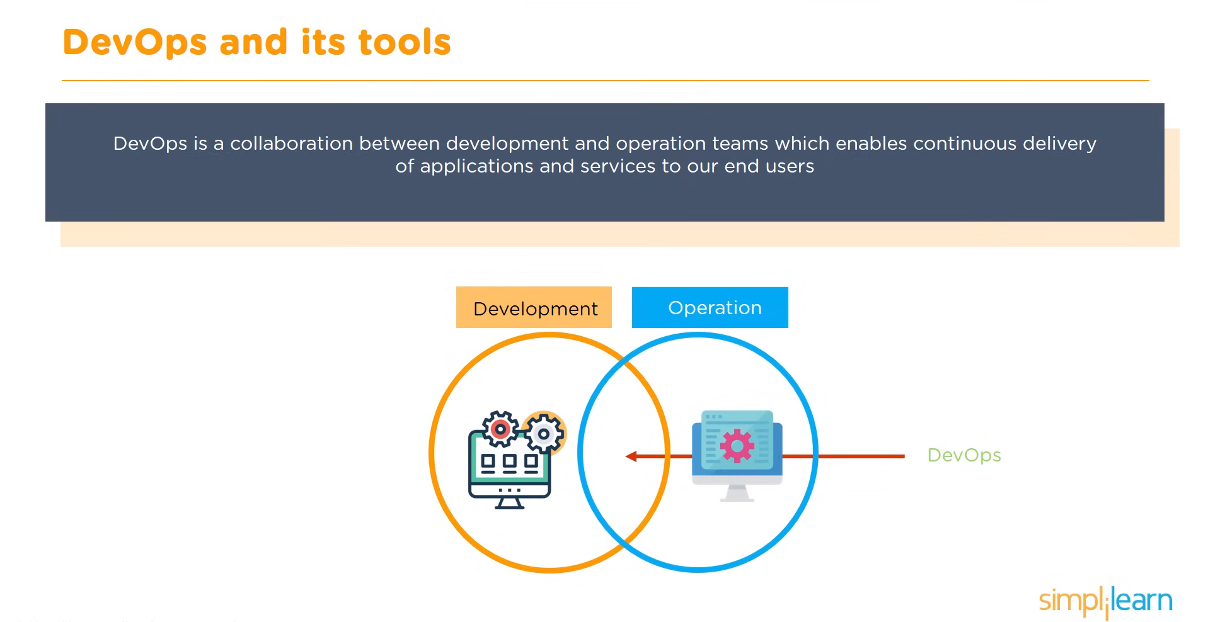

Slide 15
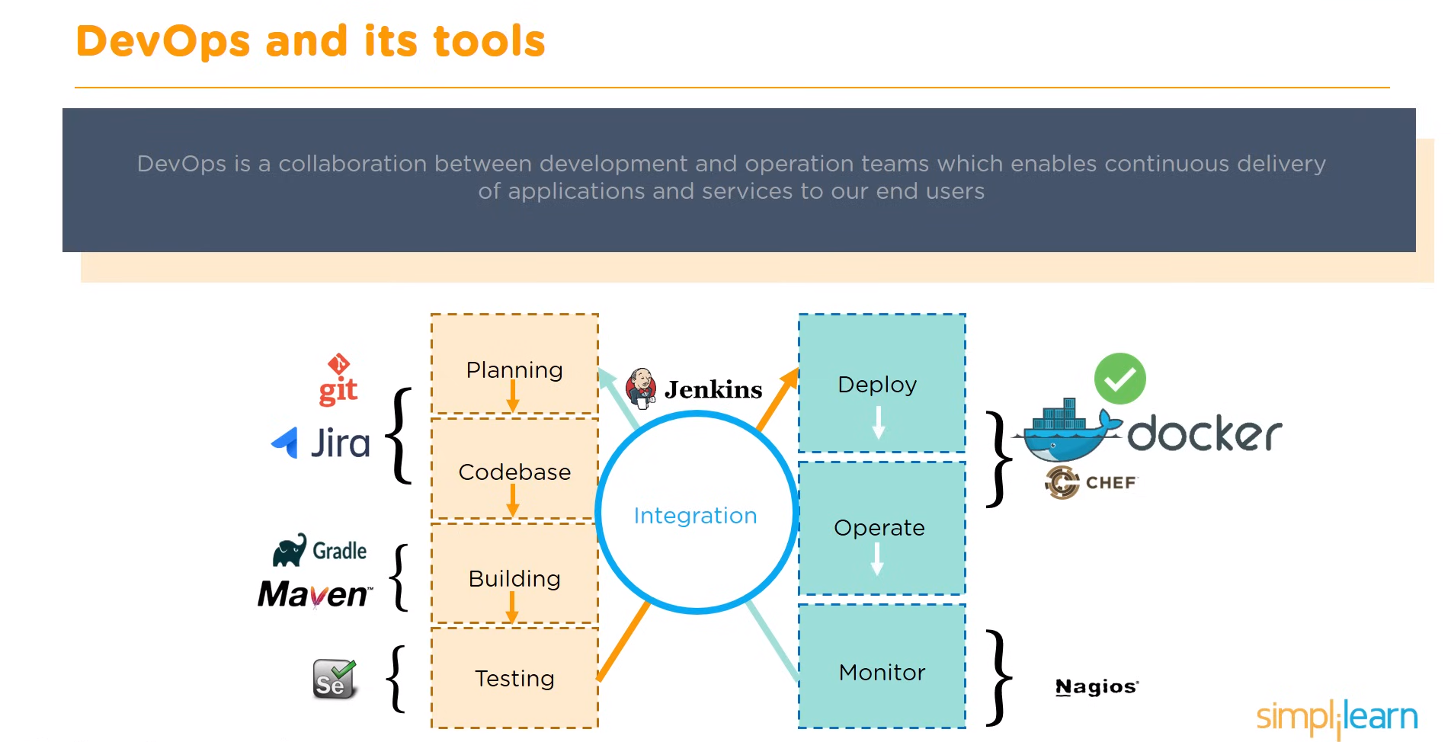

Slide 16
THANK
YOU!
POWERPOINT PRESENTATION

Slide 17
